Slide 1
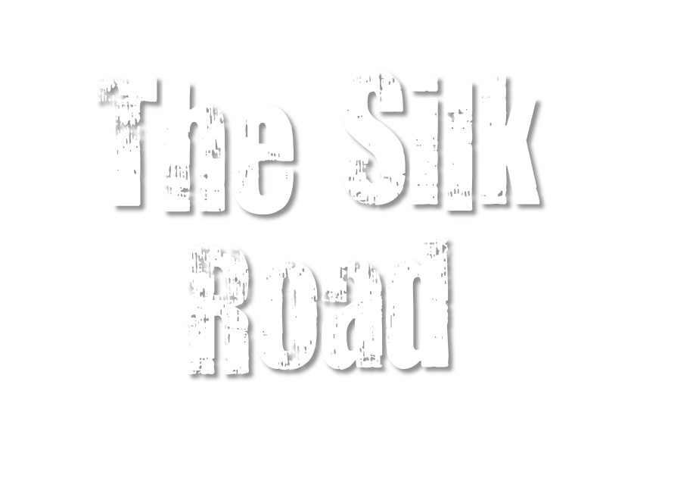
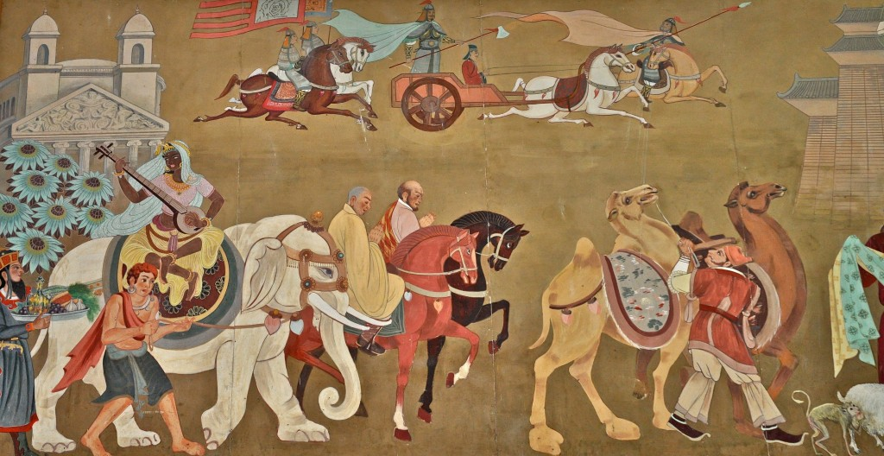
Regional Stability, Nomads & Luxury Goods

Slide 2
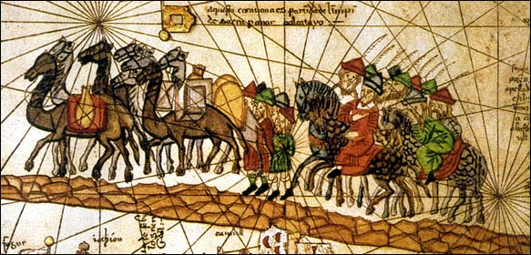
Stability Brings Trade
Classical civilizations develop stability
Governments in China, India, and the Mediterranean provide order and safety
Stability allowed traders and travelers to move safely between regions

Slide 3
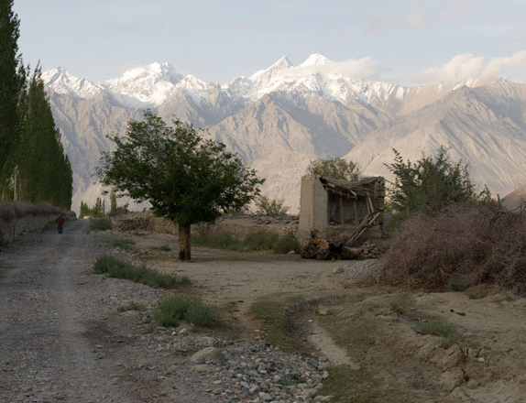
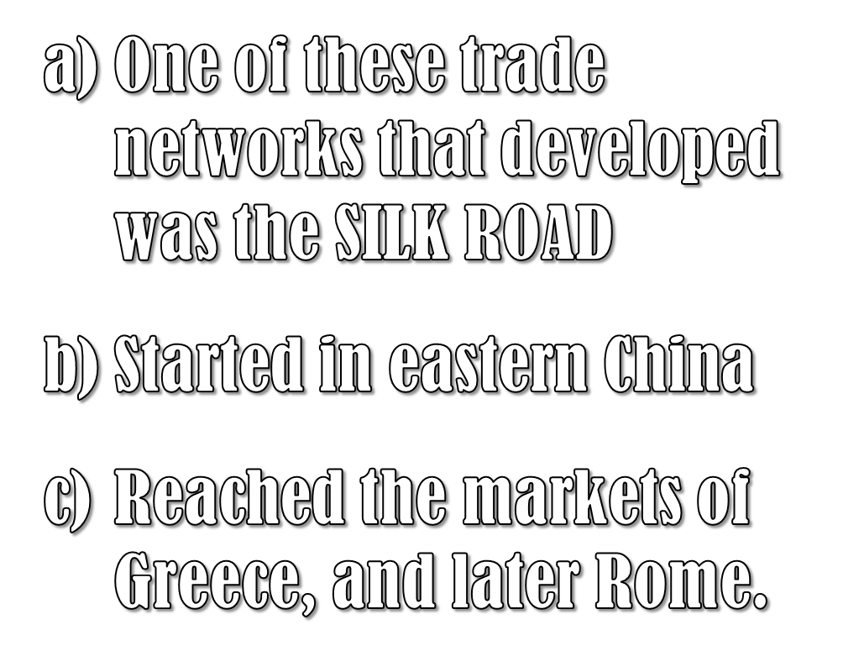
The Silk Road

Slide 4
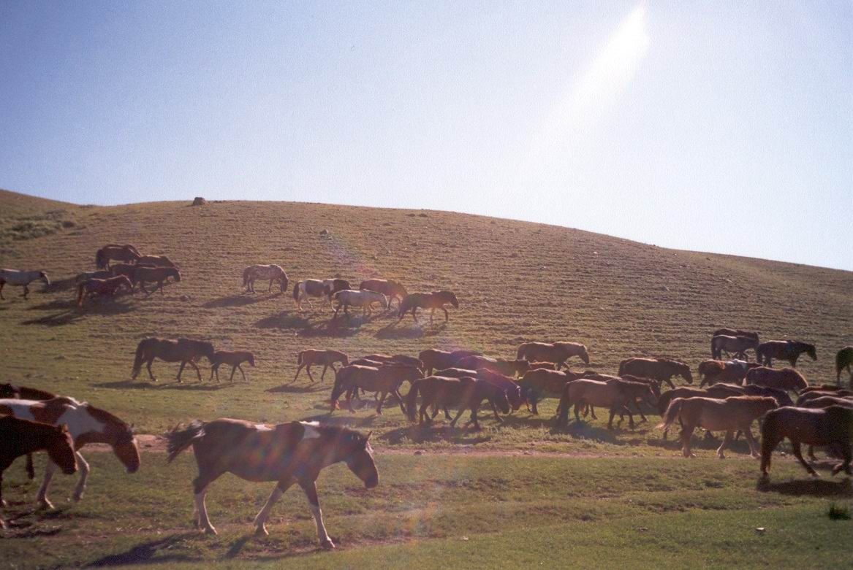
The Chinese began trading silk for horses with Central Asian nomads.

Slide 5
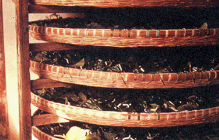
Silkworms feeding on mulberry leaves

Slide 6
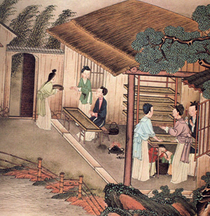
Duties of women included reeling silk and spinning

Slide 7
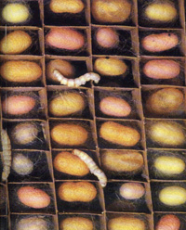
China guarded the secret of silkworms from the West until about 550 CE

Slide 8
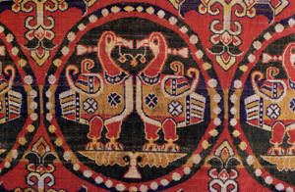
Silk from 8th century CE

Slide 9
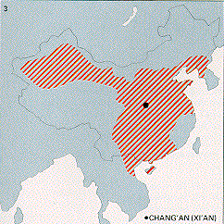
The Silk Road was begun by China during the Han dynasty 206 BCE-220 CE)

Slide 10
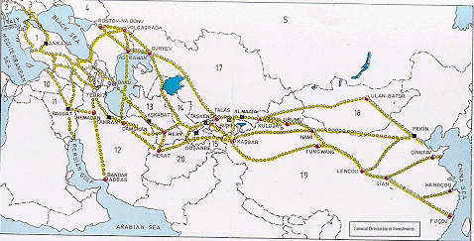
The Silk Road was many trade routes connecting East and West

Slide 11
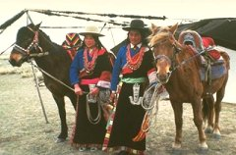
Goods WEST to China => horses, foods
Goods China to West => silk, spices, fruits

Slide 12
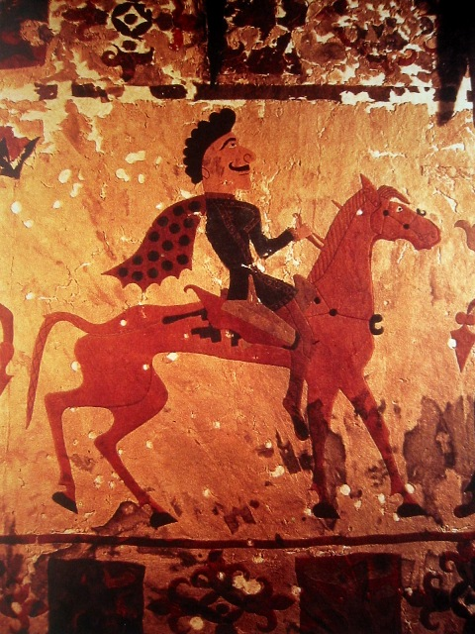
Items were traded from station to station as Central Asians played key roles of middlemen and carriers

Slide 13
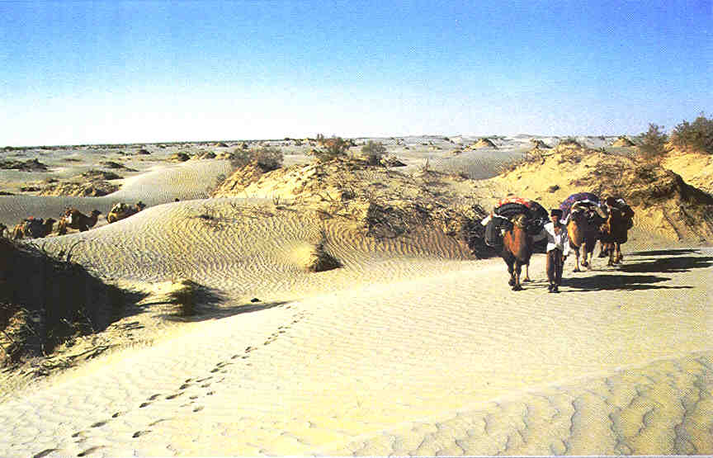
The desert and mountainous terrain made for difficult travel

Slide 14
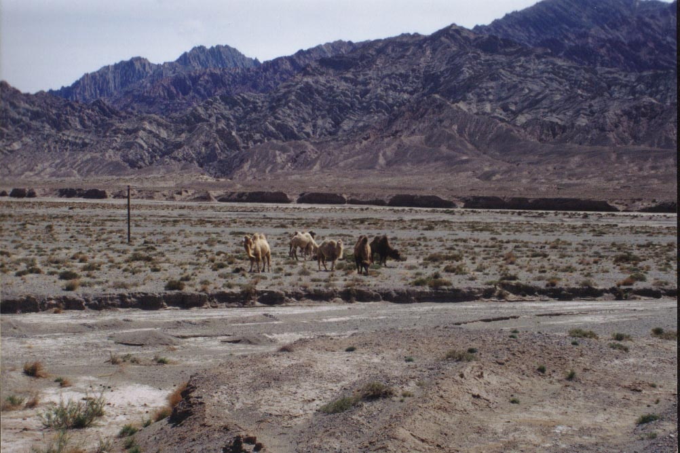
Camels were main form of transport

Slide 15
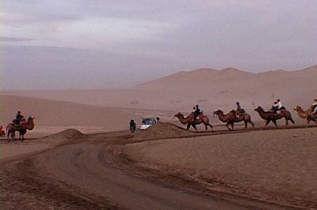
Caravan of Camels were popular by 1 CE

Slide 16
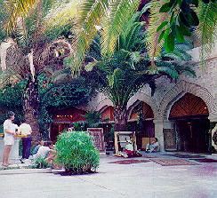
As the land of the Silk Road did not allow for frequent rest stops, caravanserais were formed to provide food and safety.

Slide 17
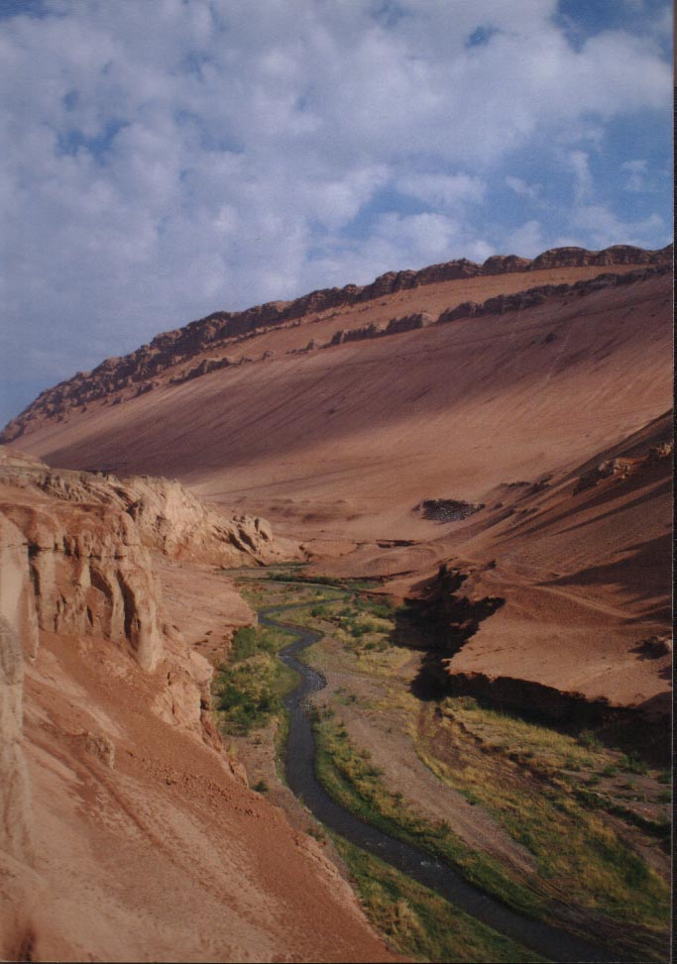
Caravanserais were located in areas that could support some level of settlement, such as this desert oasis

Slide 18
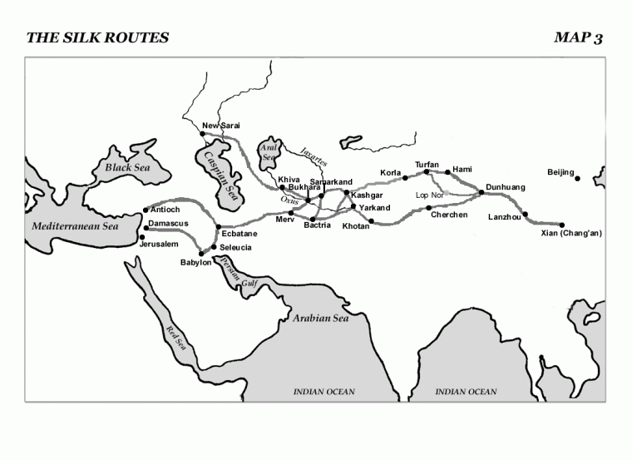
Stopping places for merchants and travelers led to the formation of cities in previously undeveloped areas

Slide 19
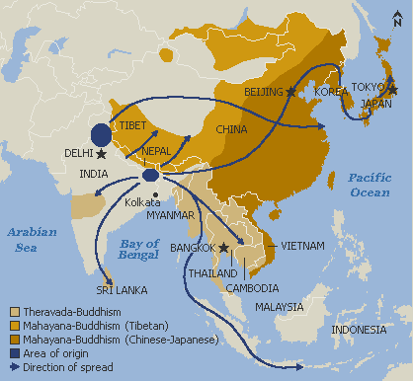
Buddhism spread from India along the Silk Roads

Slide 20
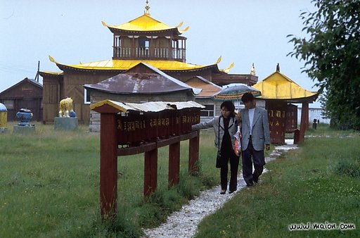
Merchants supported Buddhist monasteries

